Slide 1
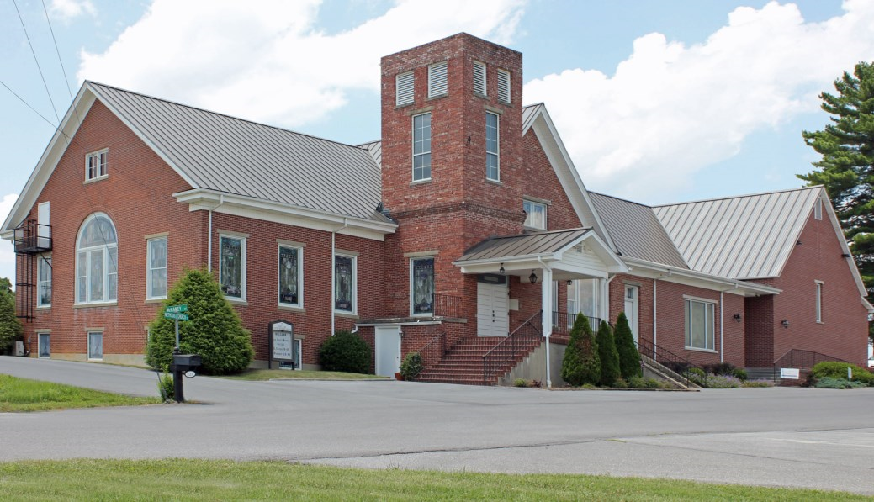
WELCOME
PINEY FLATS UNITED METHODIST CHURCH
We’re glad you’re here!

Slide 2
Welcome to Worship
We pray that this will be a meaningful time as we praise God, enjoy Christian Fellowship, and seek the guidance of God’s Holy Spirit

Slide 3
Will meet on Thursday, May 2nd at 12:00 p.m.
for “Lunch in the Lot”
More information to come, mark your
Calendars and plan to join us!

Slide 4
Backpacks are back again this year!
Items needed:
Packs of 10-12 black or blue pens
Packs of 10-12 pencils
Pencil Top or block erasers
Small pencil sharpeners
Please bring your donated items to the Church and
leave in the designated box in the Fellowship Hall.
Thank you for your support of United Women In Faith!

Slide 5
Busy Baskets have been updated and have been placed throughout the
Sanctuary. If you are new to our Service and have children, please
complete an information sheet for each child. The information sheets
ensure that you can be notified of a “need” while your child is in
Children’s Church. These are on purple paper and located at each
entrance of the Church.

Slide 6
Covered Dish Wednesday
Mark your Calendar for May 1st @ 6:00 p.m.
In the Fellowship Hall
This Gathering is a nice time to fellowship with
Fellow church members and enjoy a
good home cooked meal!

Slide 7
Our Prayer Shawl Cabinet is overflowing with Prayer Shawls. If you know someone that is in need of prayer or comfort, please ask for a shawl. It will be put in a plastic bag, placed on the altar table, and prayed over. Please contact Mae Coats (maecoats7@gmail.com or 423-276-4085). If you should need a shawl during the week, we have a tub of shawls that have already been prayed over. They are on the floor beside the Prayer Shawl Cabinet.
Thank you, Mae Coats

Slide 8
Are You New to
Piney Flats UMC?
We are so glad you are here!! Please complete a visitor’s information card found at either entrance so that we may follow up on your visit with us.

Slide 9
SNACK TIME
Snacks, coffee and juice is available at the kitchen window
Grab some and enjoy the fellowship!!
A sign-up sheet is in the Fellowship Hall if you are willing to provide snacks on Sunday morning.

Slide 10
Education Committee will meet Today
April 14th
directly following Worship in the
Fellowship Hall

Slide 11
“Joy Comes with the Morning”
Todays Scripture
Psalm 30:5
John 21:1-9

Slide 12
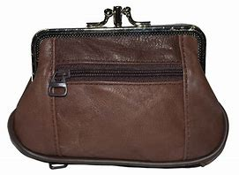
Local Missions
Purse-onality!!
You will find multiple purses on the Local Missions table in the Fellowship Hall. Please pick one out and fill with hygiene essentials: toothbrush, toothpaste, comb, brush, deodorant and lotion. Be Creative and add things you think a woman would like in her purse. We will continue to accept these until all purses have been filled!
Thank you for all your support of Local Missions!!

Slide 13
All Levels
Thursday 4:00 pm - 5:00 pm
In Fellowship Hall
Open to everyone -
beginners welcome and encouraged
Mats provided – cost is only $5.00
Yoga - Thursday Nights

